Slide 1
The chain rule and the Jacobian: how a slope travels backwards through a model made of many steps
A model is a long chain of steps from the input to the loss. How does the slope of the loss reach a number buried many steps deep?
Mathematics for AI and Machine Learning | Session 9 of 18 | Calculus and optimisation
KLAi Professional Learning | Jotham Martin Wambi
Notes:
Welcome to Session 9. In Session 8 you computed a gradient by a direct formula. Real models are not one formula. They are many steps stacked on top of each other, and the slope has to be passed back through every step. The tool for that is the chain rule.
Today we learn it with small numbers, draw it as a graph, see what happens when one value feeds two paths, and meet the Jacobian, the matrix version of a slope.

Slide 2



Today in one view: what you will leave with
By the end of today you can
Differentiate a function of a function with the chain rule and check the answer with a finite difference
Draw a computation graph, compute forward values and backward derivatives, and add the slopes when a value feeds two paths
Write down and compute the Jacobian matrix of a vector function with two inputs and two outputs
Notes:
By the end of today you can do three things. First, differentiate a function of a function with the chain rule, and check the result with ordinary arithmetic. Second, draw a computation graph and run it twice, forwards to get values and backwards to get derivatives, and add the slopes when one value feeds two paths.
Third, write down the Jacobian, the matrix that holds every slope of a function with several inputs and several outputs, and compute it for two inputs and two outputs. Everything today feeds Session 11, where you build backpropagation by hand.

Slide 3
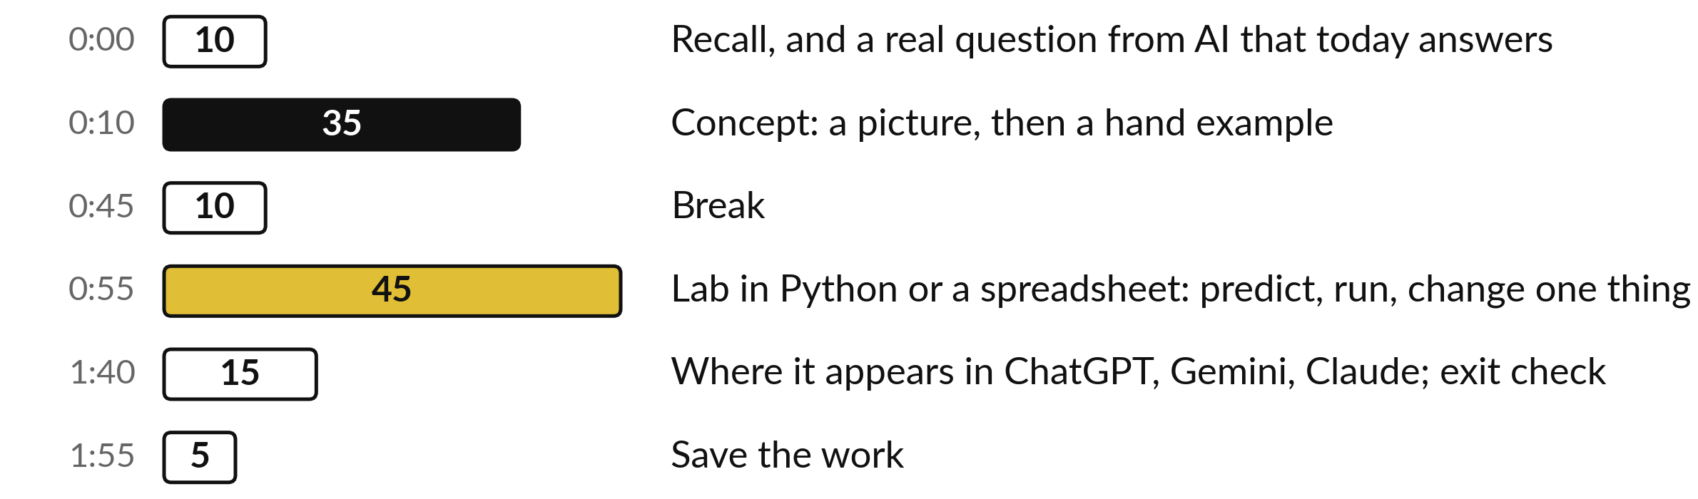
Your two hours: chain rule,
graphs, the Jacobian, then the lab
Pictures and hand examples first, then the lab on the same numbers in Python or a spreadsheet.
Notes:
A short recall of Session 8 and the question for today come first. Then thirty-five minutes of concepts, with a picture first and then a calculation by hand. After the break you spend forty-five minutes in the lab, in Python or in a spreadsheet, on the same delivery data as the last two sessions.
The last twenty minutes show where this appears in AI and give you an exit check.

Slide 4
Three questions from last time
1. What is a partial derivative?
2. What is the gradient, and which way does it point?
3. The loss of the line y-hat = b + w x at w = 1, b = 0 has gradient (-18.5, -6.5). What does it tell you to do?
Answer aloud first. Then we check together.
Notes:
Three quick questions from Session 8. Answer aloud first, and then we check together. It is a warm-up to bring last time back.
Question one. What is a partial derivative? Take a moment.
A good answer is this. The slope of a function when you change one input and hold all the other inputs fixed.
Question two. What is the gradient, and which way does it point? Say it to yourself first.
A good answer is this. The column of all the partial derivatives. It points in the direction of steepest increase, so training steps along minus the gradient.
Question three. The loss of the line y-hat = b + w x at w = 1, b = 0 has gradient (-18.5, -6.5). What does it tell you to do? Think about your own task as you answer.
A good answer is this. Raise both w and b, because both entries are negative. The w entry is larger in size (18.5 against 6.5), so the loss is more sensitive to w here.
If an answer was missing, do not worry. Your notes from last class have it. Now to today.

Slide 5
Answers to the three questions from Session 8
Question | Short answer
What is a partial derivative? | The slope of a function when you change one input and hold all the other inputs fixed.
What is the gradient, and which way does it point? | The column of all the partial derivatives. It points in the direction of steepest increase, so training steps along minus the gradient.
The loss of the line y-hat = b + w x at w = 1, b = 0 has gradient (-18.5, -6.5). What does it tell you to do? | Raise both w and b, because both entries are negative. The w entry is larger in size (18.5 against 6.5), so the loss is more sensitive to w here.
If one answer surprised you, look back at Session 8 before the lab.
Notes:
A partial derivative is the slope when you change one input and hold the others fixed. The gradient is the column of all the partial derivatives. It points to steepest increase, so training steps along minus the gradient. And at w equal to one and b equal to zero, both entries of the gradient are negative, so we raise both parameters, and the loss is more sensitive to w, because its entry is larger in size.
Today the question is how such a gradient is found when the model has many steps.

Slide 6




Words we use today
Word | What it means
Composite function | A function of a function: the output of one function becomes the input of the next. Written f(g(x)).
Chain rule | The derivative of a composite function is the derivative of the outer function times the derivative of the inner function.
Computation graph | A picture of a calculation as boxes (values) and arrows (operations), from the inputs to the loss.
Jacobian | The matrix of all the partial derivatives of a function with several inputs and several outputs. One row for each output, one column for each input.
Backpropagation | Computing the derivatives of the loss by applying the chain rule backwards through the computation graph.
Notes:
Five words for today. I give the plain meaning of each, and we use every one of them before the end of the session.
Composite function. A function of a function: the output of one function becomes the input of the next. Written f(g(x)).
Chain rule. The derivative of a composite function is the derivative of the outer function times the derivative of the inner function.
Computation graph. A picture of a calculation as boxes (values) and arrows (operations), from the inputs to the loss.
Jacobian. The matrix of all the partial derivatives of a function with several inputs and several outputs. One row for each output, one column for each input.
Backpropagation. Computing the derivatives of the loss by applying the chain rule backwards through the computation graph.

Slide 7
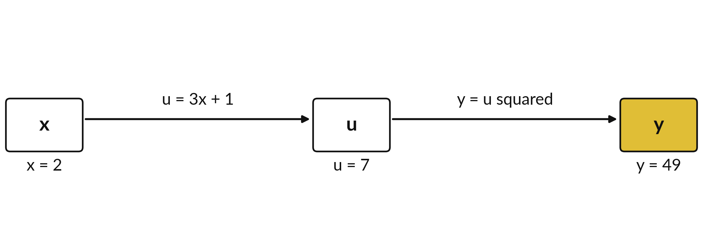
A function of a function: the output of
one step becomes the input of the next
Two steps. The input x = 2 becomes u = 7, and u becomes y = 49.
Notes:
A function of a function is called a composite function. We start with x equal to two. The first step makes u, which is three x plus one, so u is seven. The second step takes u and squares it, so y is forty-nine. The output of the first step is the input of the second.
We write the whole thing as y equals f of g of x, where g is the inner step and f is the outer step. A model is exactly this, with many more steps.

Slide 8
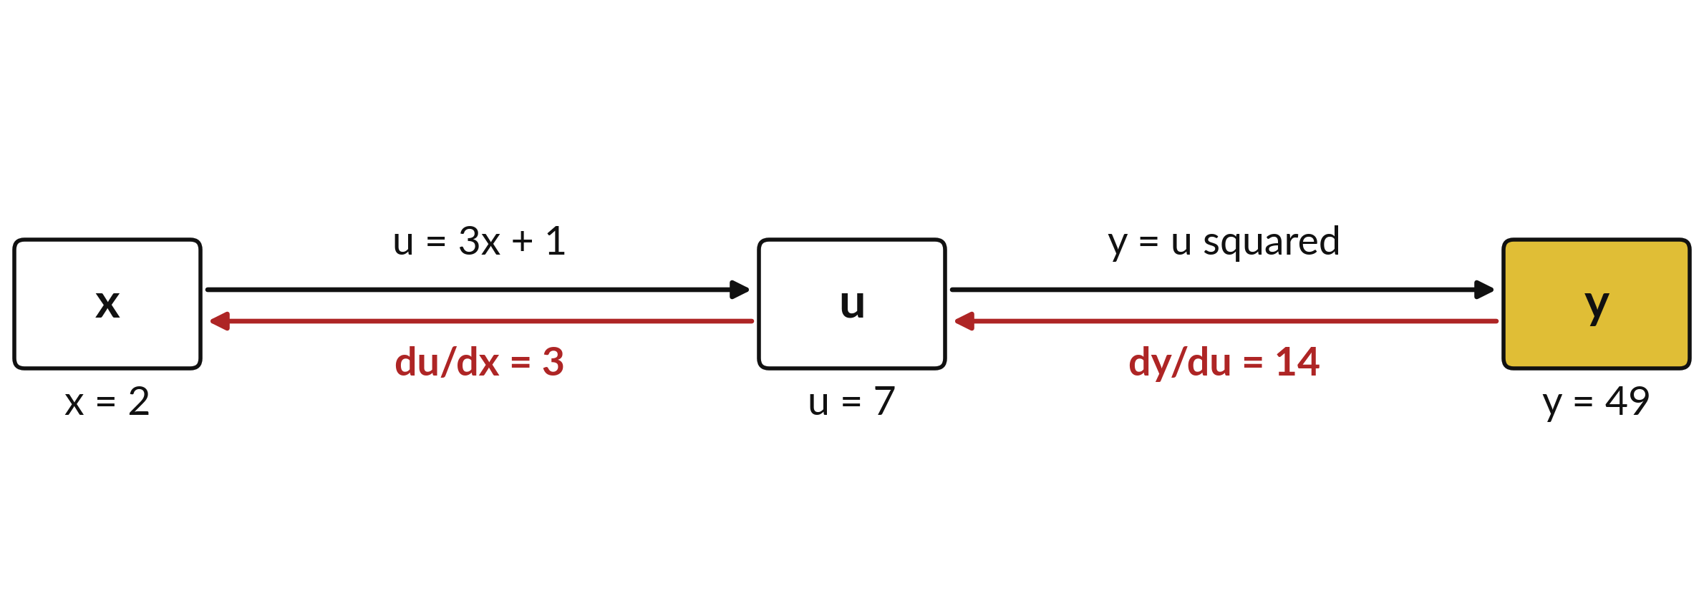
The chain rule: slopes along the chain multiply
A tiny step in x moves u 3 times as far; in u, y 14 times as far. So y moves 3 × 14 = 42 times as far.
Notes:
The first step has slope three: a tiny step in x moves u three times as much. The second step, squaring, has slope two u, which is fourteen at u equal to seven. A tiny step in u moves y fourteen times as much. So a tiny step in x moves u three times as much, and that moves y fourteen times as much again.
The total is three times fourteen, forty-two times as much. That is the chain rule: slopes along the chain multiply. Can you see why they multiply and not add?

Slide 9
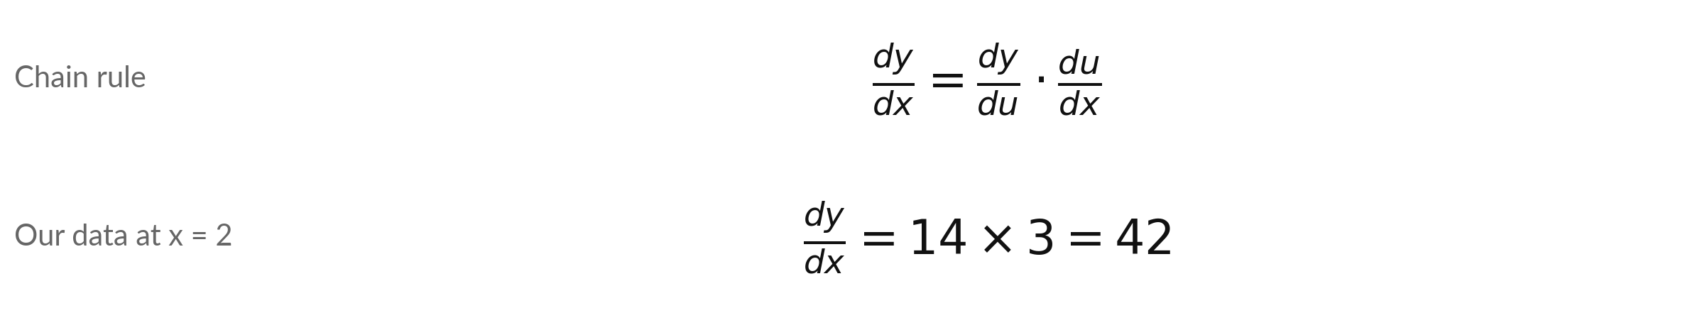
The chain rule: dy/dx is dy/du times du/dx
Symbol | What it means | In our data
y = f(u) | The outer function: it takes u and returns y. | y = u squared; dy/du = 2u = 14 at u = 7
u = g(x) | The inner function: it takes x and returns u. | u = 3x + 1; du/dx = 3
dy/dx | The slope of the whole chain: how fast y changes when x changes. | 42 at x = 2
Evaluate dy/du at the value of u that the forward step produced (u = 7), never at x.
Notes:
As a formula, the slope of y with respect to x equals the slope of y with respect to u, times the slope of u with respect to x. In our example the outer function is y equals u squared, so its slope is two u, which is fourteen at u equal to seven.
The inner function is u equal to three x plus one, with slope three. Multiply and you get forty-two. One detail matters. The outer slope is evaluated at the value of u that the forward step produced. Using x there would give two times two, four, a wrong answer.

Slide 10
Check the chain rule with a finite
difference: y = (3x + 1) squared at x = 2
Step h | y(2 + h) | y(2) | Forward slope = (y(2 + h) minus y(2)) / h
1 | 100 | 49 | 51.0000
0.1 | 53.29 | 49 | 42.9000
0.01 | 49.4209 | 49 | 42.0900
0.001 | 49.042009 | 49 | 42.0090
The slopes settle on 42, the chain rule answer. The central difference with h = 0.001 gives 42.0000. In the lab you check every chain rule answer this way.
Notes:
We nudge x by a small step h and divide the change in y by h. With h equal to one, the slope is fifty-one, which is too crude. As h shrinks the slopes settle on forty-two, the chain rule answer. With h equal to point zero zero one, y is forty-nine point zero four two zero zero nine, and the forward slope is 42.009.
The central difference, which looks on both sides, gives 42.000. This is the same check you used in Sessions 7 and 8. If the check gave fourteen, you would suspect a missing inner slope.

Slide 11
The chain rule on three functions at x = 1
Function y(x) | Inner u | Outer in u | du/dx | dy/du | dy/dx at x = 1
y = (3x + 1) squared | 3x + 1 | u squared | 3 | 2u = 8 | 24
y = e to the 2x | 2x | e to the u | 2 | e^u = 7.389 | 14.778
y = ln(x squared + 1) | x squared + 1 | ln u | 2x = 2 | 1/u = 0.5 | 1
The second row explains the remark in Session 7: e to the 2x has slope 2 times e to the 2x.
Notes:
Three functions at x equal to one. The first is the one we just did, moved to x equal to one: the outer slope two u is eight, the inner slope is three, so twenty-four. The second is e to the two x. The inner function is two x with slope two, the outer function is e to the u, whose slope is e to the u, seven point three eight nine, so the answer is fourteen point seven seven eight.
That is the remark from Session 7. The third is the natural logarithm of x squared plus one. The inner slope is two x, the outer slope is one over u, which is one half, and the product is one.

Slide 12


Keep the inner slope, and
multiply the slopes along a chain
Forgetting the inner slope
Adding along a chain
The slope of u squared is 2u.
But u = 3x + 1 also changes with x.
Multiply by du/dx = 3 as well.
Slopes along a chain multiply.
14 + 3 = 17 is wrong here.
14 times 3 = 42 is right.
Outer slope times inner slope, each evaluated at its own value.
Notes:
The first trap is forgetting the inner slope. If you differentiate u squared and write two u, you have only done the outer step. Since u itself depends on x, you must also multiply by the slope of the inner step. In our example that gives fourteen, instead of forty-two.
The second trap is adding the slopes along a chain. If a step makes u grow three times as fast as x, and y grows fourteen times as fast as u, the effects compound, so we multiply. Adding has its place, but only between separate paths, which comes later today. The finite difference check catches both mistakes.

Slide 13
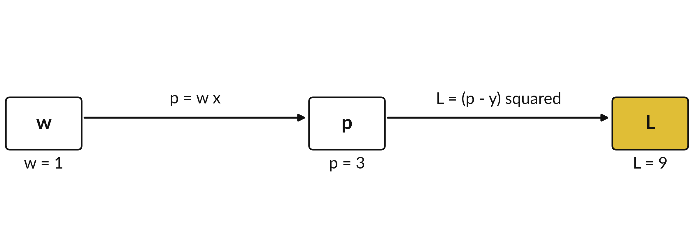
A computation graph draws a calculation as
boxes for values and arrows for operations
One delivery, x = 3 km, y = 6. Forward pass: p = 1 × 3 = 3, then L = (3 - 6) squared = 9.
Notes:
A computation graph for the model you know. Take one delivery, three kilometres, fee six thousand shillings. The model predicts p equals w times x. With w equal to one, p is three. The loss for that delivery is p minus six, squared, which is nine. Each box holds a value, and each arrow is an operation.
Running the graph from left to right, from the parameter to the loss, is called the forward pass. Session 11 builds the full forward and backward pass for a small network. What would be a third step in a bigger model?

Slide 14
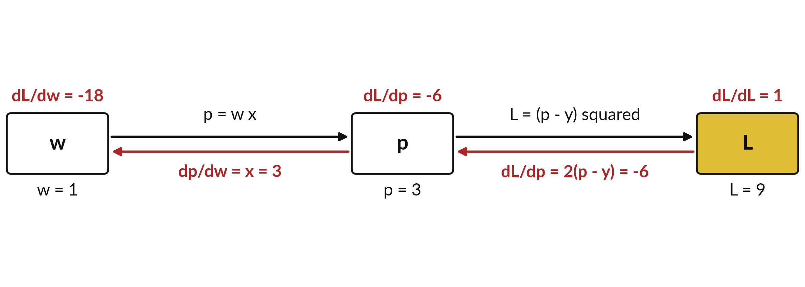
Backward: each box gets the
slope of the loss with respect to it
Black: forward values. Red: the backward pass. Start at 1 and multiply by each local slope.
Notes:
The backward pass is in red. We start at the loss, where the slope of L with respect to itself is one. Moving one step back, the local slope of the loss with respect to p is two times p minus y, which is minus six. So the red value at p is minus six.
Moving one more step back, the local slope of p with respect to w is x, which is three. The red value at w is minus six times three, minus eighteen. Each red value is the previous red value times the local slope of one arrow. Why is the red value at w the slope we wanted?

Slide 15
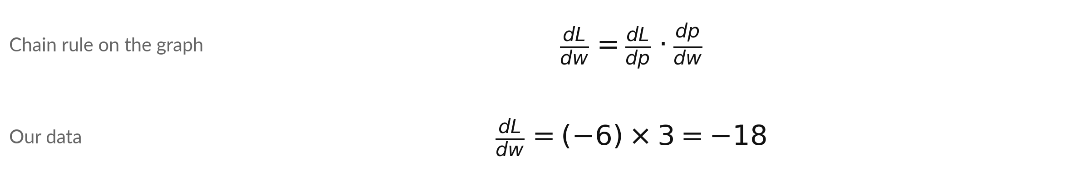
Backward pass on the tiny graph:
multiply the local slopes along the path
Symbol | What it means | In our data
dL/dp | Local slope of the loss in p: 2 (p - y). The 2 of Sessions 7 and 8. | -6
dp/dw | Local slope of p in w: p = w x, so x. The x_i of Sessions 7 and 8. | 3
dL/dw | The slope of the loss in w: the product of the two. | -18
A local slope is the derivative of one box's output with respect to its own input.
Notes:
The same result as a formula. The slope of L with respect to w equals the slope of L with respect to p times the slope of p with respect to w. The first factor is two times p minus y, two times minus three, minus six. The second is x, three.
The product is minus eighteen. This closes the loop from Sessions 7 and 8: the two and the x in the loss slope come from these two local slopes. Nudging w by point zero zero one up and down gives losses 8.982 and 9.018, and the central difference is minus eighteen. The negative sign says raise w.

Slide 16
Backward values for all four deliveries at
w = 1: the average is the Session 8 slope
Row i | Distance x | Error p minus y | dL/dp = 2 e | dL/dw = x times dL/dp
1 | 1 | -2 | -4 | -4
2 | 2 | -3 | -6 | -12
3 | 3 | -3 | -6 | -18
4 | 4 | -5 | -10 | -40
Mean |  |  |  | -18.5
Row 3 is the graph we just drew: -6 and -18. The mean loss has the mean of the four backward values: -18.5, as in Sessions 7 and 8.
Notes:
For each of the four deliveries we run the tiny graph backwards. The error p minus y is minus two, minus three, minus three and minus five. Twice the error gives the slope of that row loss in p, and multiplying by x gives the slope in w, minus four, minus twelve, minus eighteen and minus forty.
Row three is exactly the graph we drew. The loss of the whole dataset is the mean of the four row losses, so its slope is the mean of the four backward values, minus seventy-four over four, minus eighteen point five. That is the same number you found in Sessions 7 and 8 by the direct formula.

Slide 17
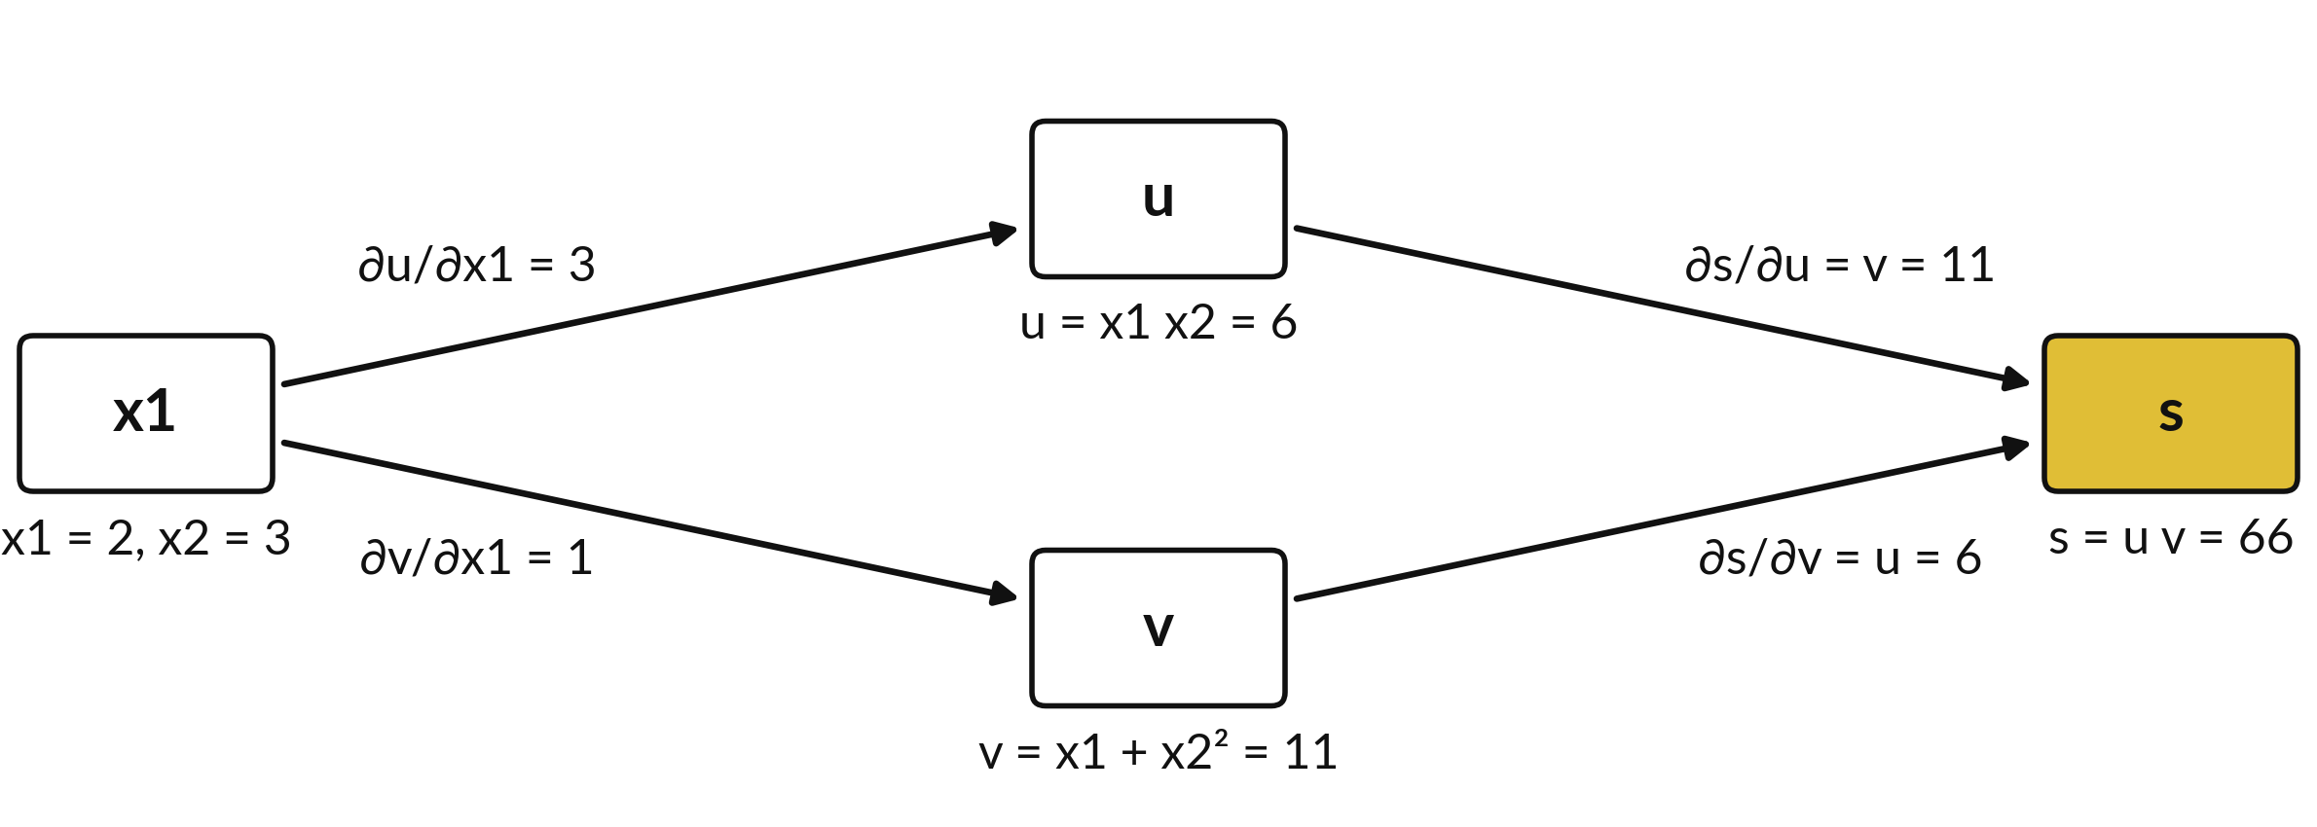
When one input feeds two boxes,
the slopes along the two paths add
Through u: 11 × 3 = 33. Through v: 6 × 1 = 6. Add the paths: ∂s/∂x1 = 39.
Notes:
A new situation. Here x one feeds two boxes. The box u is x one times x two, and the box v is x one plus x two squared, at x one equal to two and x two equal to three, so u is six and v is eleven.
Then s is u times v, sixty-six. Nudge x one and both u and v move, and each carries the change to s along its own path. Along each path we multiply, as before: through u, eleven times three is thirty-three; through v, six times one is six.
The two effects arrive at s together, so they add: thirty-nine. Multiply along a path, add across paths. Session 11 needs this rule for every weight in a network.

Slide 18
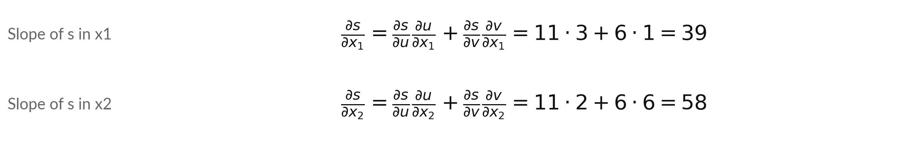
The multivariable chain rule: multiply
along each path, then add the paths
Symbol | What it means | In our data
u, v | Two boxes fed by the inputs: u = x1 x2 and v = x1 + x2 squared. | u = 6, v = 11 at (2, 3)
∂s/∂u, ∂s/∂v | The slopes of s = u v in each box: v and u. | 11 and 6
∂u/∂x2, ∂v/∂x2 | Local slopes of the boxes in x2: x1 and 2 x2. | 2 and 6
Check: s = x1² x2 + x1 x2³, so ∂s/∂x1 = 2 x1 x2 + x2³ = 12 + 27 = 39 and ∂s/∂x2 = x1² + 3 x1 x2² = 4 + 54 = 58.
Notes:
The rule written out. The slope of s in x one is the slope of s in u times the slope of u in x one, plus the slope of s in v times the slope of v in x one: eleven times three plus six times one, thirty-nine.
For x two, the local slopes of u and v are two and six, so the sum is eleven times two plus six times six, fifty-eight. You can check both without the rule, because s expands to x one squared x two plus x one x two cubed.
Its partial derivatives are thirty-nine and fifty-eight. Keep these two numbers; the Jacobian will produce them again.

Slide 19
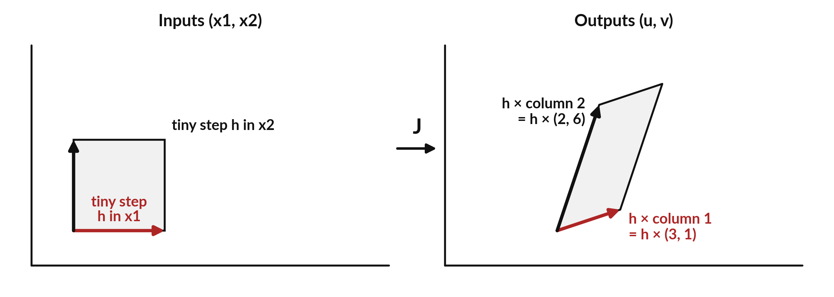
A vector function has several outputs:
the Jacobian holds every slope
A tiny square with sides h becomes almost a parallelogram: its sides are h times the columns of J.
Notes:
The pair of boxes u and v is one function with two inputs and two outputs, F of x one and x two. Take a very small square of inputs near the point two, three, with sides of a tiny length h. The function sends that square to almost exactly a parallelogram.
Its sides are h times three, one and h times two, six, the two columns of a two by two matrix called the Jacobian. So near one point, the function acts like the matrix multiplication you met in Session 3. A bigger column means that input moves the outputs more.

Slide 20
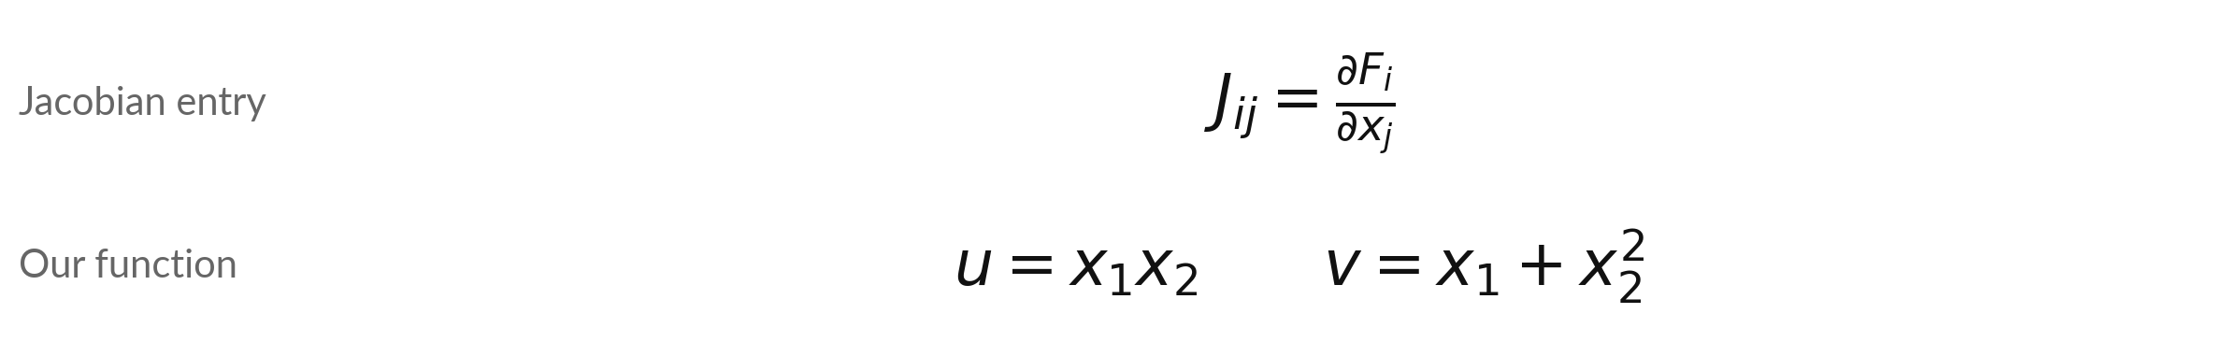
The Jacobian: one row for each
output, one column for each input
Symbol | What it means | In our data
F_i | Output i of the function F. Here F_1 = u, F_2 = v. | at (2, 3): u = 6, v = 11
x_j | Input number j. Here x_1 and x_2. | the point (2, 3)
J_ij | The slope of output i in input j. J has 2 rows and 2 columns. | J = rows (3, 2) and (1, 6)
Row 1: ∂u/∂x1 = x2 = 3, ∂u/∂x2 = x1 = 2. Row 2: ∂v/∂x1 = 1, ∂v/∂x2 = 2 x2 = 6.
Notes:
The Jacobian entry in row i and column j is the partial derivative of output i with respect to input j. Our function has u equal to x one times x two, and v equal to x one plus x two squared. At the point two, three the outputs are six and eleven.
The first row holds the slopes of u: with respect to x one it is x two, which is three, and with respect to x two it is x one, which is two. The second row holds the slopes of v: one, and two times x two, which is six.
These are the four local slopes on the arrows of the two-path picture.

Slide 21
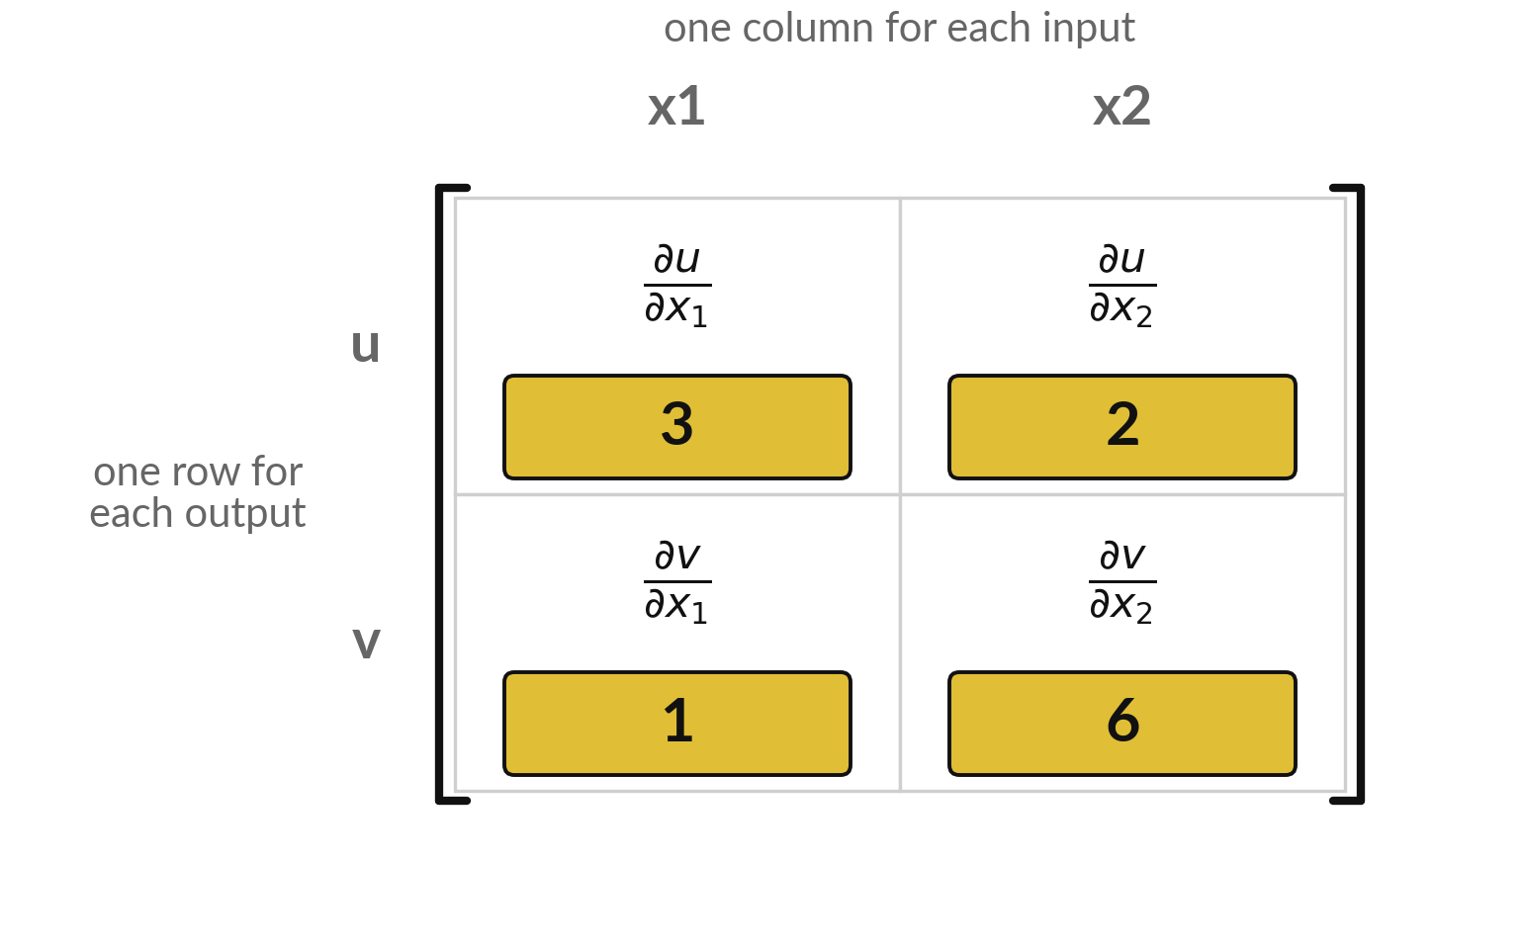
The Jacobian drawn as a matrix,
with the numbers at the point (2, 3)
Each gold number is one partial derivative at the point (2, 3).
Row u: x2 = 3 and x1 = 2. Row v: 1 and 2 x2 = 6.
Check: nudging x2 from 3 to 3.001 raises v by 0.006001, so 6.001 per unit.
One nudge of one input gives a whole column.
Notes:
The same Jacobian drawn as a matrix. The rows are the outputs, u and v, and the columns are the inputs, x one and x two. To check one entry, nudge x two from three to three point zero zero one with x one held fixed. The output v goes up by point zero zero six zero zero one, so the slope is six point zero zero one, close to six, and the central difference gives exactly six.
That one nudge also moves u, so it checks the whole second column. A function with a thousand inputs would need a thousand nudges, which is why libraries use the chain rule instead.

Slide 22
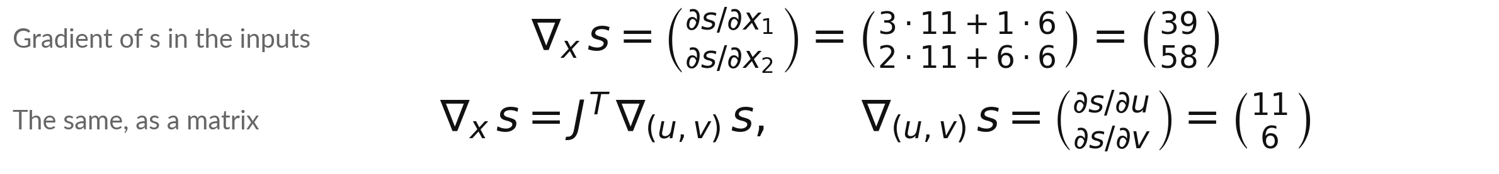
Stack the two path sums and you get J
transposed times the slopes of the outputs
Symbol | What it means | In our data
nabla_x s | The gradient of s with respect to the inputs x1 and x2: a column, as in Session 8. | (39, 58)
nabla_(u,v) s | The gradient of s with respect to the outputs u and v: s = u v, so (v, u). | (11, 6)
J transposed | Rows and columns of J swapped. Row 1 of Jᵀ is column 1 of J, (3, 1): the slopes of u and v in x1. | rows (3, 1) and (2, 6)
Each row of Jᵀ dotted with (11, 6) is one path sum. In text, columns are written across, as (11, 6).
Notes:
Put the two path sums from before in one column. The top entry was three times eleven plus one times six. Three and one are the first column of J, the slopes of u and v in x one. So the top entry is column one of J dotted with eleven, six.
The bottom entry is column two, two and six, dotted with eleven, six, which is fifty-eight. Taking the columns of J as rows is the transpose. So the gradient of s in the inputs is J transposed times the gradient of s in the outputs. Nothing new happened: it is the add-the-paths rule, written as a matrix.

Slide 23
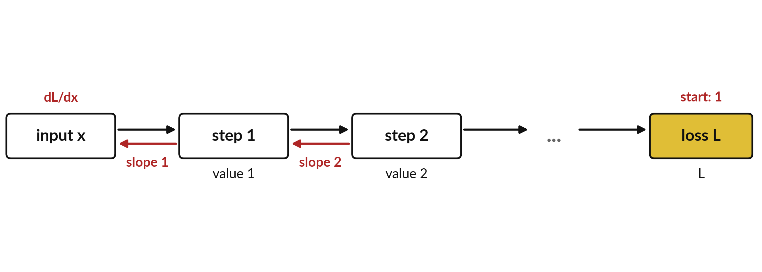
Many steps: the backward value is the product
of the local slopes along the whole chain
Start at the loss with 1. Going back, multiply by each local slope (red). Where paths split, add them.
Notes:
Put as many boxes between the input and the loss as you like. Going backwards, each box multiplies the running value by one more local slope. After the first step back you have one slope. After the second you have the product of two slopes, and so on.
Where a value feeds several boxes, the paths add, as you just saw. A model with dozens of layers has dozens of such factors, and each one is computed by the same two rules that you used today. Running this backwards through a whole network is called backpropagation, and Session 11 builds it by hand.

Slide 24
Four lines of Python run the tiny
graph forward and then backward
In plain words
p = w * x
L = (p - y) ** 2
dL_dp = 2 * (p - y)
dL_dw = dL_dp * x
print(p, L, dL_dp, dL_dw)
Lines 1 and 2: the forward pass. p is the prediction, L the loss.
Line 3: the local slope of the loss in p, 2 (p - y).
Line 4: times the local slope of p in w, which is x. This is the chain rule.
With w = 1, x = 3, y = 6 it prints 3, 9, -6 and -18.
3.0 9.0 -6.0 -18.0
Notes:
Before the lab, the recipe. The first two lines are the forward pass: the prediction p and the loss L. The third line is the local slope of the loss with respect to p, two times p minus y. The fourth line multiplies it by the local slope of p with respect to w, which is x.
That is the chain rule in code. With w equal to one, x equal to three and y equal to six, it prints three, nine, minus six and minus eighteen. The notebook then checks it by nudging w. In the spreadsheet the same steps become columns.

Slide 25
Part 2: the lab
Close the slides. Open the notebook or the workbook.
Notes:
Over to you. Everything you need is on the slides, and each step of the lab explains itself. Please open the Python notebook or the spreadsheet workbook now. Both use the same numbers, so you can compare with someone who chose the other tool. Work through the steps in order.
Raise your hand if a cell gives an error. Remember the rhythm: predict first, then run, then change one thing.

Slide 26
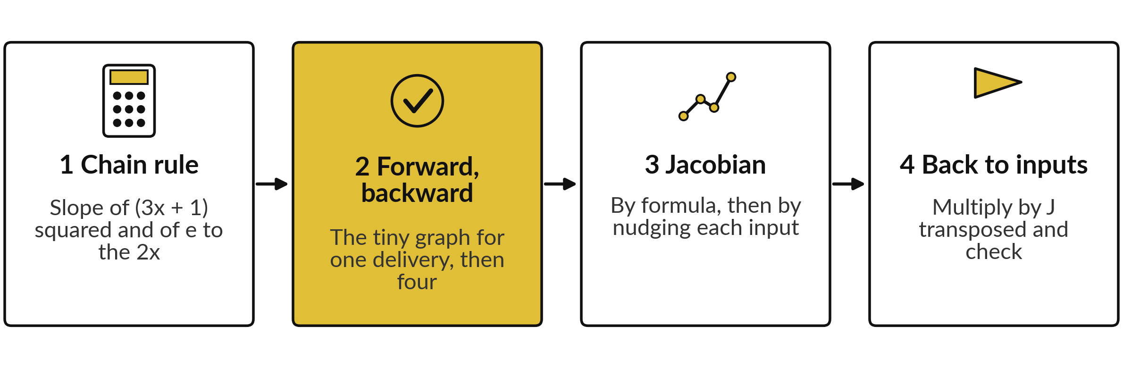
The lab checks every slope today twice:
once by rule and once by nudging
Python: Steps 1 to 6 of the notebook. Spreadsheet: sheets Chain, Backward and Jacobian. Predict first, then run.
Notes:
Stage one computes the chain rule slope of two composite functions and checks them by nudging. Stage two runs the tiny graph forward and backward for one delivery, and then for all four rows. Stage three computes the Jacobian by formula and by nudging each input. Stage four multiplies by J transposed, the add-the-paths rule, to bring the slopes back to the inputs, and checks the answer.
In Python you work through steps one to six. In the spreadsheet you use three sheets, named Chain, Backward and Jacobian.

Slide 27






Expect 42, then -6 and -18, then a
Jacobian with rows (3, 2) and (1, 6)
What you compute | You should see
Chain rule slope of (3x + 1) squared at x = 2 | 42
Chain rule slope of e to the 2x at x = 1 | 14.778
Forward values for the delivery x = 3, y = 6 at w = 1: p and L | 3 and 9
Backward values: dL/dp and dL/dw | -6 and -18
Mean of the four dL/dw values at w = 1 | -18.5
Jacobian of (x1 x2, x1 + x2 squared) at (2, 3) | rows (3, 2) and (1, 6)
Gradient of s = u v in the inputs, J transposed times (11, 6) | (39, 58)
If your number differs, stop and ask. Do not change a number to match. Find the step that went wrong.
Notes:
Use this table as your checkpoint, and call me if a number differs. The chain rule slope is forty-two, and for e to the two x it is fourteen point seven seven eight. For the tiny graph the forward values are three and nine, and the backward values minus six and minus eighteen.
The mean of the four backward values is minus eighteen point five. The Jacobian is three, two, one, six, and the gradient of s is thirty-nine and fifty-eight. Do not edit a number to make it match. Finding why it differs is the skill you will use on every project.

Slide 28




A slope of 14 or a flipped
Jacobian each have a simple cause
What you see | What it means | What to do
NameError in Python | A cell that defines a name was skipped | Run all cells from the top, in order
Chain slope is 14 instead of 42 | The inner slope du/dx was left out | Multiply by 3 as well as by 2u
Jacobian looks flipped | Rows and columns swapped: outputs are rows | Row i is output i, column j is input j
Spreadsheet shows #VALUE! | A range with text or a gap in a formula | Check that every cell in the range holds a number
Notes:
A name error means a cell was skipped, so run all cells from the top. If your chain rule slope is fourteen instead of forty-two, you left out the inner slope. If your Jacobian looks flipped, remember that outputs are rows and inputs are columns. And in the spreadsheet, a value error means a range holds text or a gap, so check that every cell in the range holds a number.
In each case the fix takes a minute once you know where to look.

Slide 29
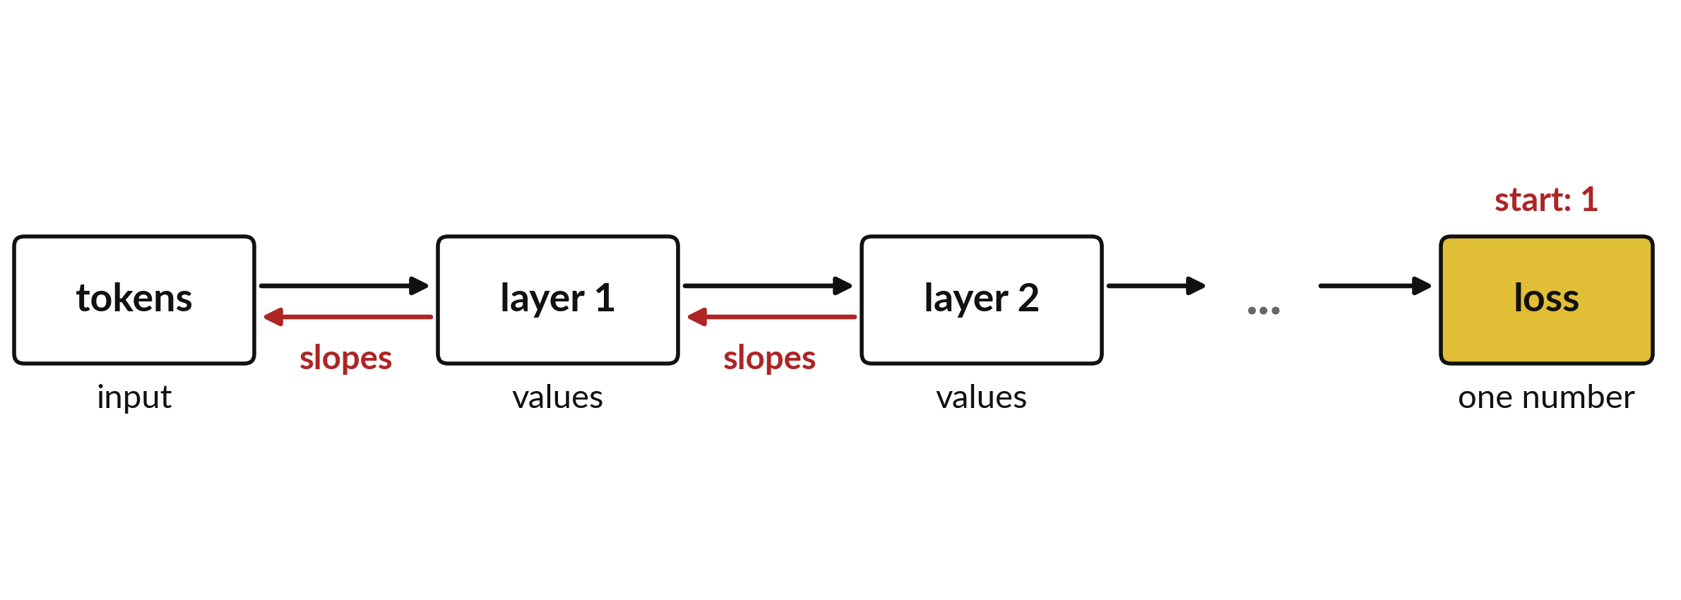
Where this appears in AI: the chain rule runs
backwards through every layer, and every step inside it
Red: backward slopes. Meta's Llama 3 paper (2024) lists 32 and 80 transformer layers (8B, 70B).
Notes:
Published language models of this kind are stacks of layers. In the open Llama 3 family, Meta's Llama 3 paper from 2024 lists thirty-two transformer layers for the eight billion model and eighty for the seventy billion model. Training does a forward pass through every layer to reach the loss, and then a backward pass through every layer, and through every step inside each layer, applying the chain rule at each one and adding over paths.
The exact designs of ChatGPT, Gemini and Claude are not published, so we do not quote their layer counts. The mathematics is the same as the tiny graph you built.

Slide 30
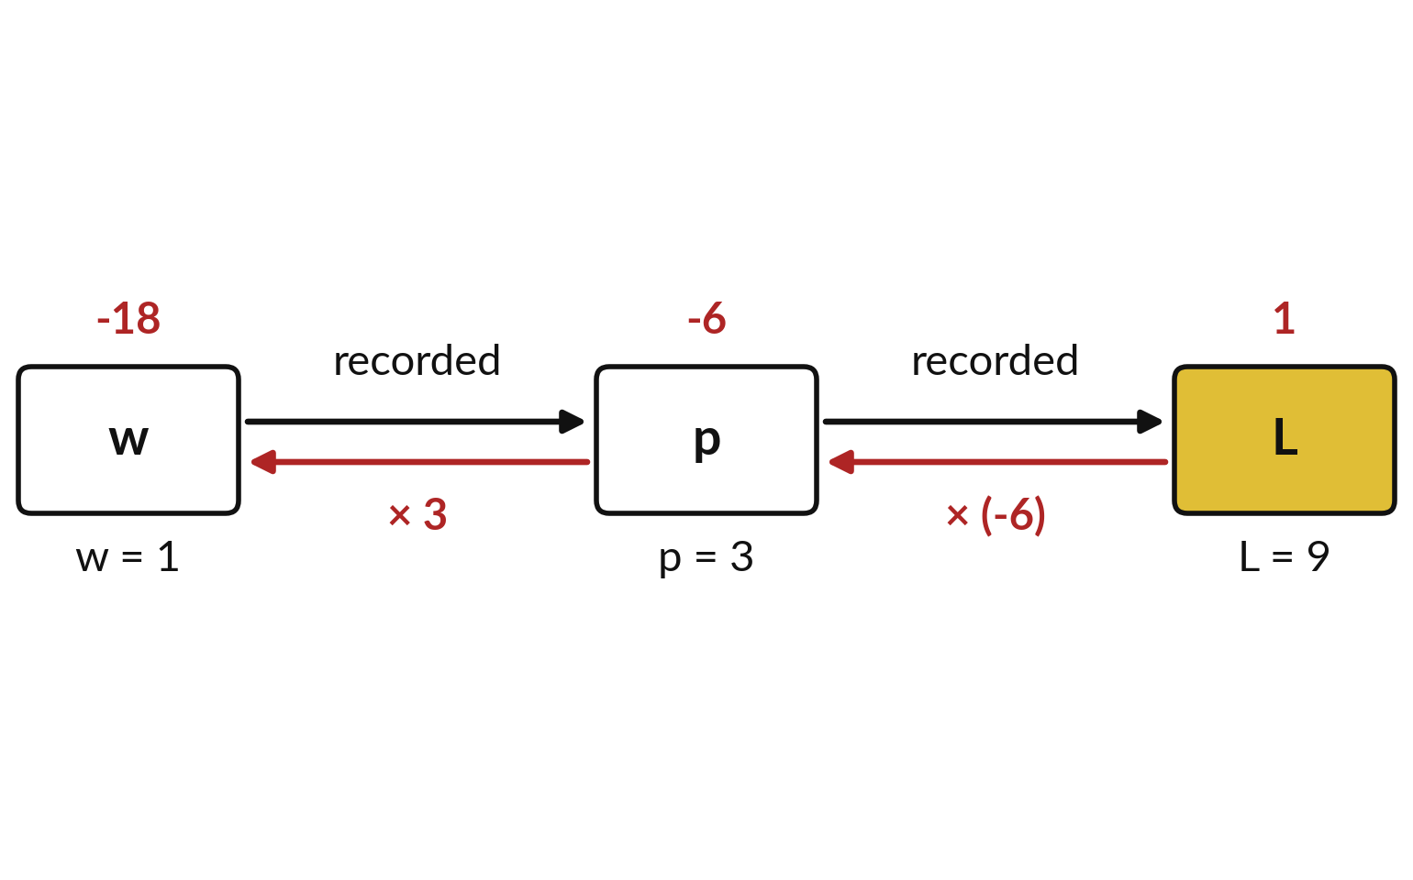
Where this appears in AI: libraries record the
graph on the way forward and replay it backwards
PyTorch (loss.backward()) and JAX (jax.grad) record each step of the forward pass, then run the chain rule backwards.
This is automatic differentiation. Nudge checks like today's are how it is tested.
Libraries never build a layer's full Jacobian. They multiply by J transposed directly: a vector-Jacobian product.
Notes:
Today you did by hand what libraries do automatically. During the forward pass, PyTorch and JAX record every step, like the black arrows here. Calling loss dot backward in PyTorch, or jax dot grad in JAX, replays the record backwards, multiplying local slopes, the red values. This is called automatic differentiation, and their manuals describe it.
The Jacobian of a whole layer can have millions of entries, so the libraries compute the product of J transposed with the incoming slopes without building J. That product is called a vector-Jacobian product. And the finite difference check you used today is how developers test that code.

Slide 31
Ask an AI assistant for this Jacobian
and check which entry is which
8 minutes
Hands-on, with any assistant
Ask an assistant for the Jacobian of F(x1, x2) = (x1 x2, x1 + x2 squared) at the point (2, 3).
You keep
One line: its Jacobian, yours, match or not. Never paste confidential data into an assistant.
Ask it to explain each entry.
Compare with ours: rows (3, 2) and (1, 6).
Run your lab Jacobian code.
If it differs, find the first entry that differs.
Notes:
A short hands-on activity. Ask any AI assistant for the Jacobian of our function, x one times x two and x one plus x two squared, at the point two, three. Our answer is three, two, one, six. Check the assistant against that and against your own lab code.
Assistants are often right on this kind of calculation, but they can swap rows and columns, so check which entry is which. If it differs, ask for the steps and find the first entry that differs. Please never paste confidential data into an assistant.

Slide 32
Exit check: a chain of slopes
and the shape of a Jacobian
Question | Short answer
What is the slope of y = (2x + 5) cubed at x = 0? | 150. Outer: 3u squared = 75. Inner: 2. Product 150.
A chain has three steps with local slopes 2, -3 and 0.5. What is the slope of the output with respect to the input? | 2 times -3 times 0.5 = -3.
What is the shape of the Jacobian of F(x1, x2) = (2 x1, x1 + x2), and what are its entries? | 2 rows (outputs) by 2 columns (inputs): rows (2, 0) and (1, 1).
Write your own answer before you read ours. The automatic check counts the lab numbers.
Notes:
Three questions to close. One: y equals two x plus five, cubed, at x equal to zero. The inner value u is five, the outer slope is three u squared, seventy-five, the inner slope is two, and the product is one hundred and fifty. Two: three local slopes, two, minus three and one half.
Multiply them and you get minus three. Three: the Jacobian has two rows, one for each output, and two columns, one for each input. The first row is two and zero, the second row is one and one. Write your own answers first, then compare. Then save your work.

Slide 33
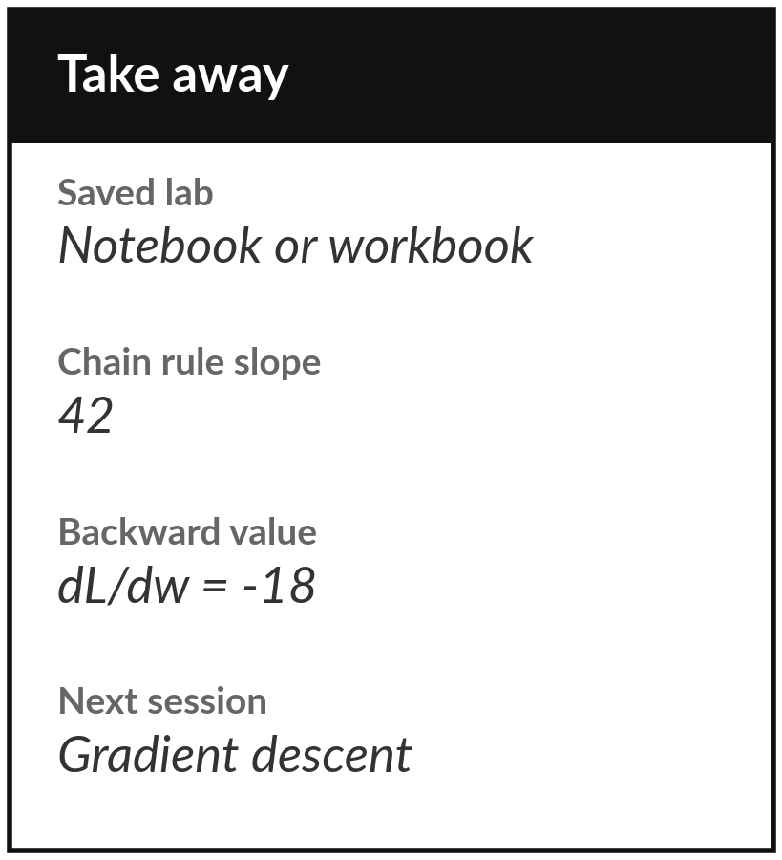
Save the lab and keep the chain rule slope,
the backward value and the Jacobian
What you keep from today
Keep your saved lab. Write down the chain rule slope 42, the backward value -18 for the tiny graph, and the Jacobian, rows (3, 2) and (1, 6).
Our question today
A model is a long chain of steps from the input to the loss. How does the slope of the loss reach a number buried many steps deep?
Next session
Session 10: gradient descent.
Notes:
Before you go, save your notebook or workbook. Keep three numbers. The chain rule slope, forty-two. The backward value for the tiny graph, minus eighteen. And the Jacobian, with rows three, two and one, six. Next session uses these slopes to take steps downhill, which is gradient descent. If anything was unclear, write the question down and bring it.
We began with this question: A model is a long chain of steps from the input to the loss. How does the slope of the loss reach a number buried many steps deep? Before you go, say in one sentence what you can now say about it.

